Slide 1

Enterprise Neurosystem
Community Overview
Notes:
An overview of the Enterprise Neurosystem open source AI R&D community.

Slide 2
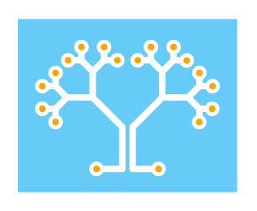
Singular AI Instance - To fully analyze events and operations at scale, AI systems must evolve beyond small islands of data and compute instances, and into a distinct and singular interpretive model that spans all data and resources, similar to a human neurosystem. Neurological Model - Human neurology is the template that the IT industry has been replicating at a subconscious level, since the inception of the data center. Autonomous and Conscious Operation - Higher order decisions are made by the conscious mind, which coexists in harmony with the autonomous and regulatory systems. The most complex human biological operations are autonomous, while partitioning conscious thought processes.
Notes:
Human and IT architectures share a number of surprising (and strong) similarities.
The arrival of AI and ML is one of the final steps in the completion of this parallel model.
Billions of IoT and mobile devices could be considered edge nerve endings, and data centers equal the brain’s core functions (cerebellum, memory, etc.).
The most complex human biological operations are autonomous - heartbeat, chemical levels, energy assimilation, etc. - while partitioned from consciousness and higher order decision processes.
In turn, the first wave of AI innovation includes a similar no touch, complete automation of complex operations. And in turn, results are provided to human management to contribute to higher order decisions.
Data in governments and multinational corporations - both real time and historical - is both massive and global in scope.
Creating an architecture that balances autonomous capability with a higher consciousness (human/machine joint decisions) is the optimal end state, and thus emulates human neurological architecture.

Slide 3
The Enterprise Neurosystem
Open source AI research community
Spans academia, government and the private sector
Architecture - AI/ML framework that enables AI model integration and data cross-correlation on a multinational scale, to assist in climate use cases
AI data output will be connected to a cross-correlation engine, using real time and historical climate data for the deepest possible insight
Uses a secure layer 7 fabric to connect all remote instances
Started in telecommunications, given inherent large scale multinational networks
Also applicable to large-scale government / corporate IT use cases
Notes:
This slide describes The Enterprise Neurosystem concept.
AI models are being deployed as point solutions for different purposes, without integration or cross-correlation.
Our community proposes to address this issue with a unified open source AI analytics framework that spans all AI Models and data sources. Much like the neurology of the human body, it is an integrated framework and cross-correlation engine for all data sources – to ultimately provide deeper insights and uncover new causes and conditions.
In the climate example, this framework would extend to atmosphere and ocean sensors, species population metrics, weather and agricultural data, satellite and space-based telescope imagery, etc. In the case of the enterprise, this would include finance, supply chains, logistics and delivery, maintenance, legal/contracts, insurance, facility security, cross-border and regulatory frameworks, taxes, etc.
This cross-functionality is due to the fact that this analytics framework is meant to be a general purpose architecture, and can be repurposed to different areas of operation.
This capability would not only increase efficiencies in every area of government, scientific and business operation, but it would provide a integrated viewpoint of unparalleled depth and clarity.
The initial community development program will include projects designed to tackle fundamental AI operations issues, each with a clear path to value. A number of working groups have been established, which include:
Secure AI Connectivity Fabric - Connectivity between AI instances and digital assets. This will be based on the Skupper upstream open source project, and a policy engine contribution from Dinesh Verma/IBM Research.
Central Analytics - This group will conduct research on the most efficient AI/NN architectures for central analysis of collective real time and historical data. The first project will be a self-identifying digital asset and model catalog, which will act as the foundation for the rest of the infrastructure stack (now underway).

Slide 4
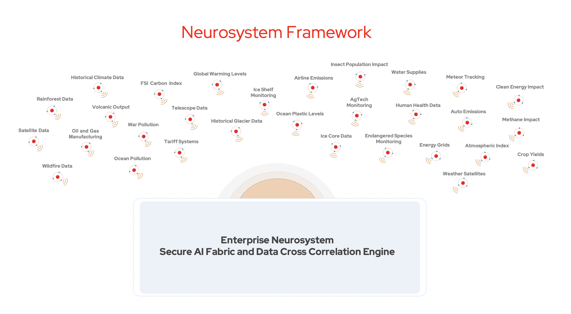
Climate Use Case
Notes:
Under discussion with the United Nations – a unified climate framework with AI cross-correlation.
A wide variety of sensors, databases and satellites will be integrated in a global AI connective fabric.
The data will be streamed in real time, then forwarded for historical analysis and cross-correlation with other data sources in the Core Intelligence engine.
Models will be developed for use by developing nations, free of charge (see Bee Population PoC, slide 14)
Leads to new discoveries for climate temperature reduction and rapid course correction.

Slide 5
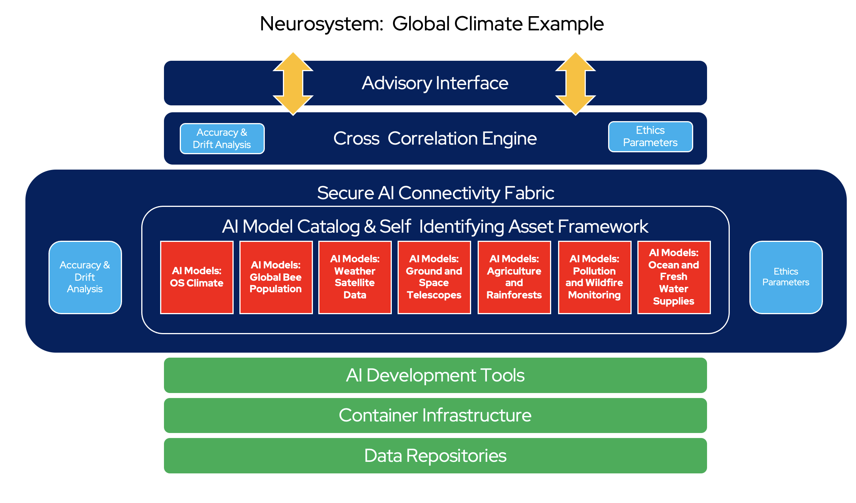
Notes:
The framework can be easily repurposed for different uses – a global climate analysis network, Smart Country management, etc.

Slide 6
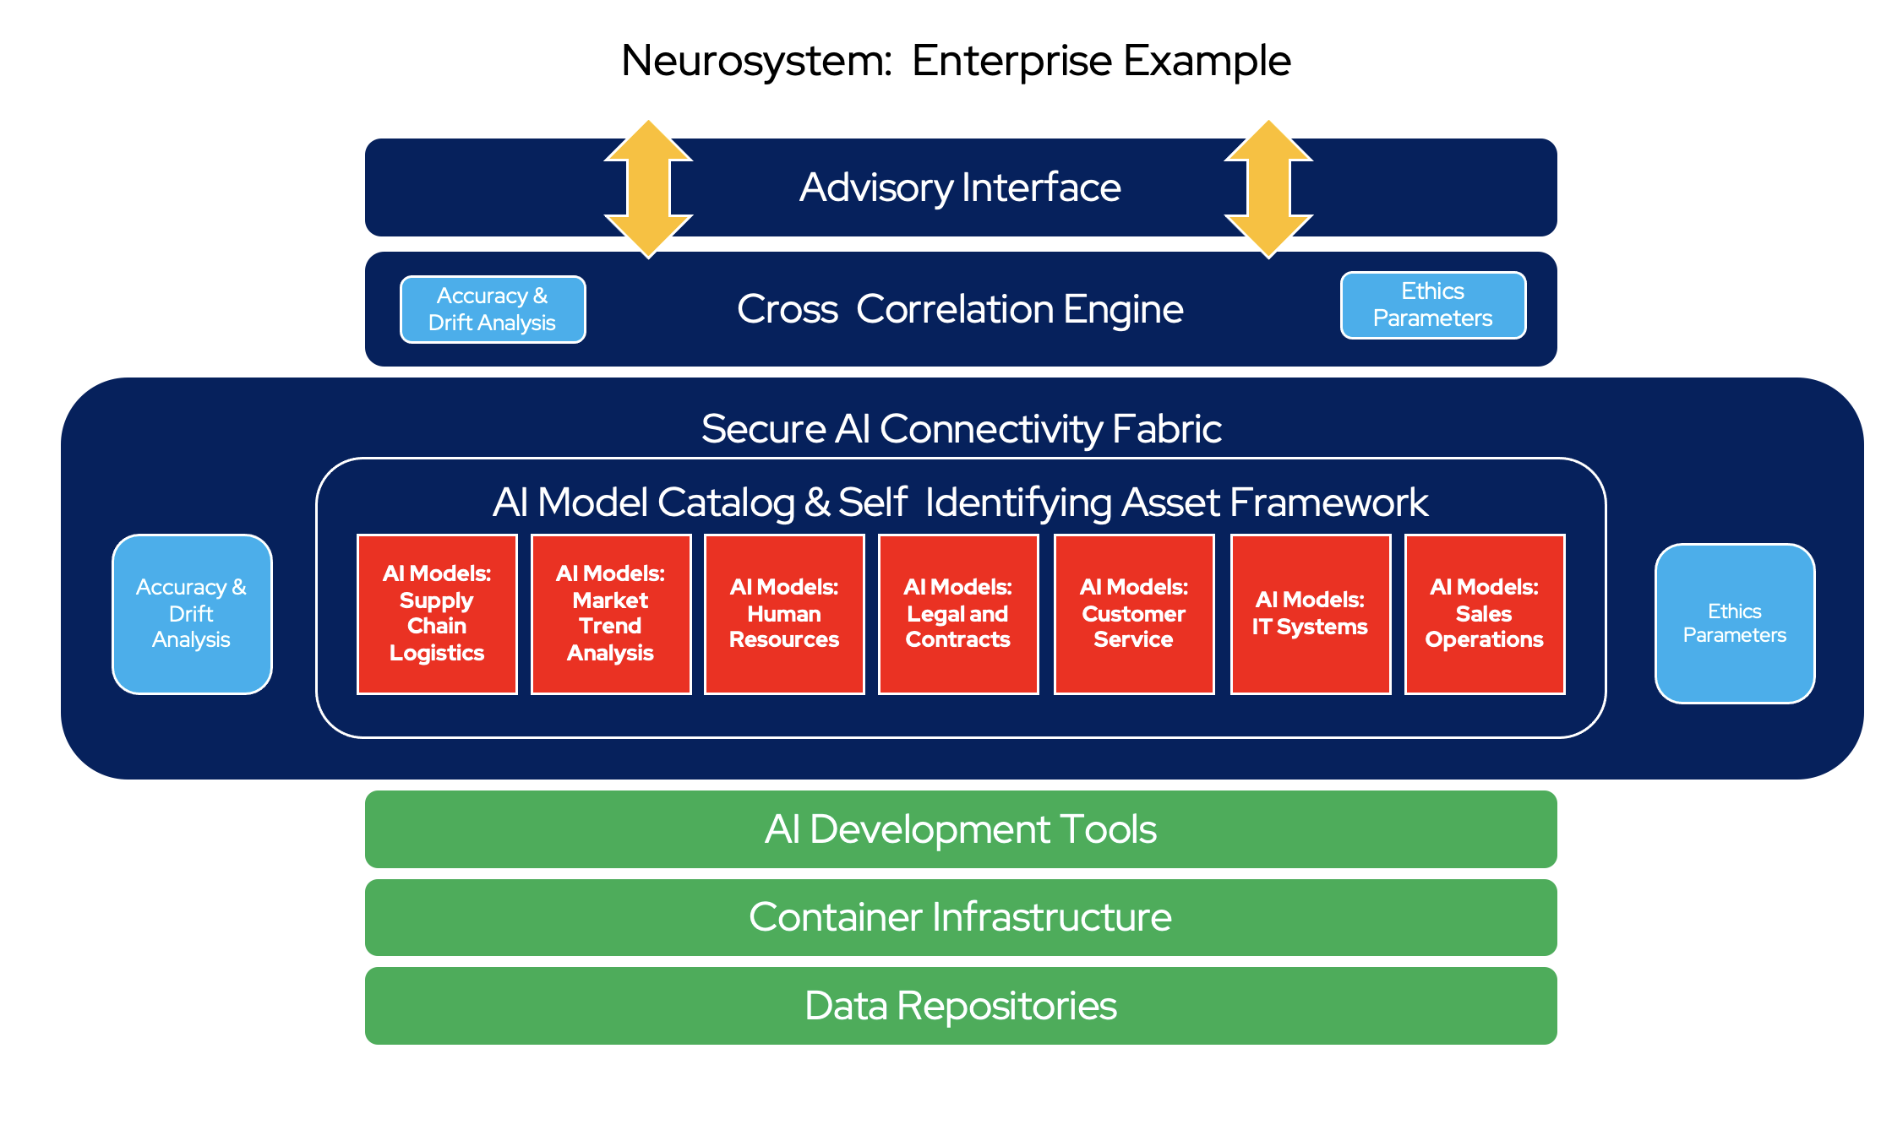
Notes:
High level architecture diagram – enterprise example.

Slide 7
Federated AI Model & Cross Correlation Example
A
ADVISOR / REPORTING INSTANCE
LAYERS 4 and 5 - HIGHER ORDER PATTERN ANALYSIS / INSIGHT
LAYERS 2 and 3 - MID-TIER DATA AGGREGATION AND PATTERN RECOGNITION
AI/ML LAYER 1 - REPORTING NODES
Notes:
Basic concept of tiered cross correlation, with new AI architectures (HTM, etc.) now under review.

Slide 8
Code in development
Foundation: Model catalog and self-identifying asset framework
Secure AI & application integration fabric
Central cross correlation AI engine and reporting instance
AI models for required Neurosystem functions
Bespoke AI models to be developed as needed
AI network security, with novel intrusion detection and network node validation
Ethical operation directives, and related data governance parameters
Notes:
Code in active development.
Self-Identifying Asset Catalog includes AI Models. Currently the foundation project now underway.
Secure AI & Application Integration Fabric is based on the Skupper open source project, and will be utilized with a Policy framework donation from Dinesh Verma/IBM Research.
Cross-correlation frameworks are under exploratory review – there is an active HTM PoC at Stanford SLAC.
Environmental AI models – Bee Population / Acoustics AI PoC now underway with Stanford SLAC support, to provide developing nations with advanced AI environmental functions.

Slide 9
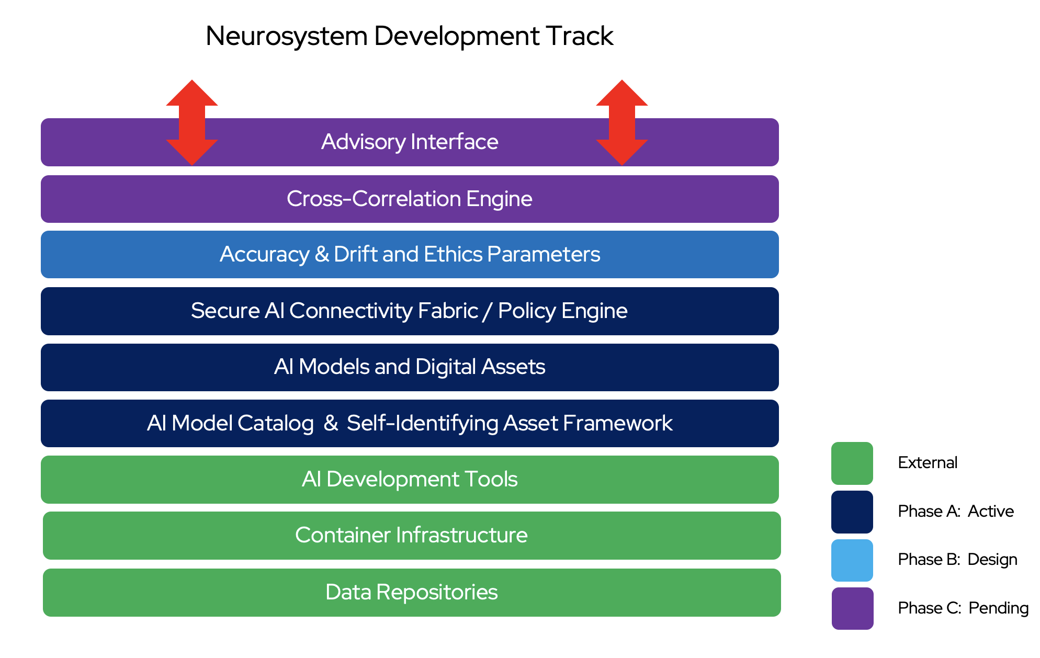
Notes:
Development objectives / status chart (as of 5/22).

Slide 10
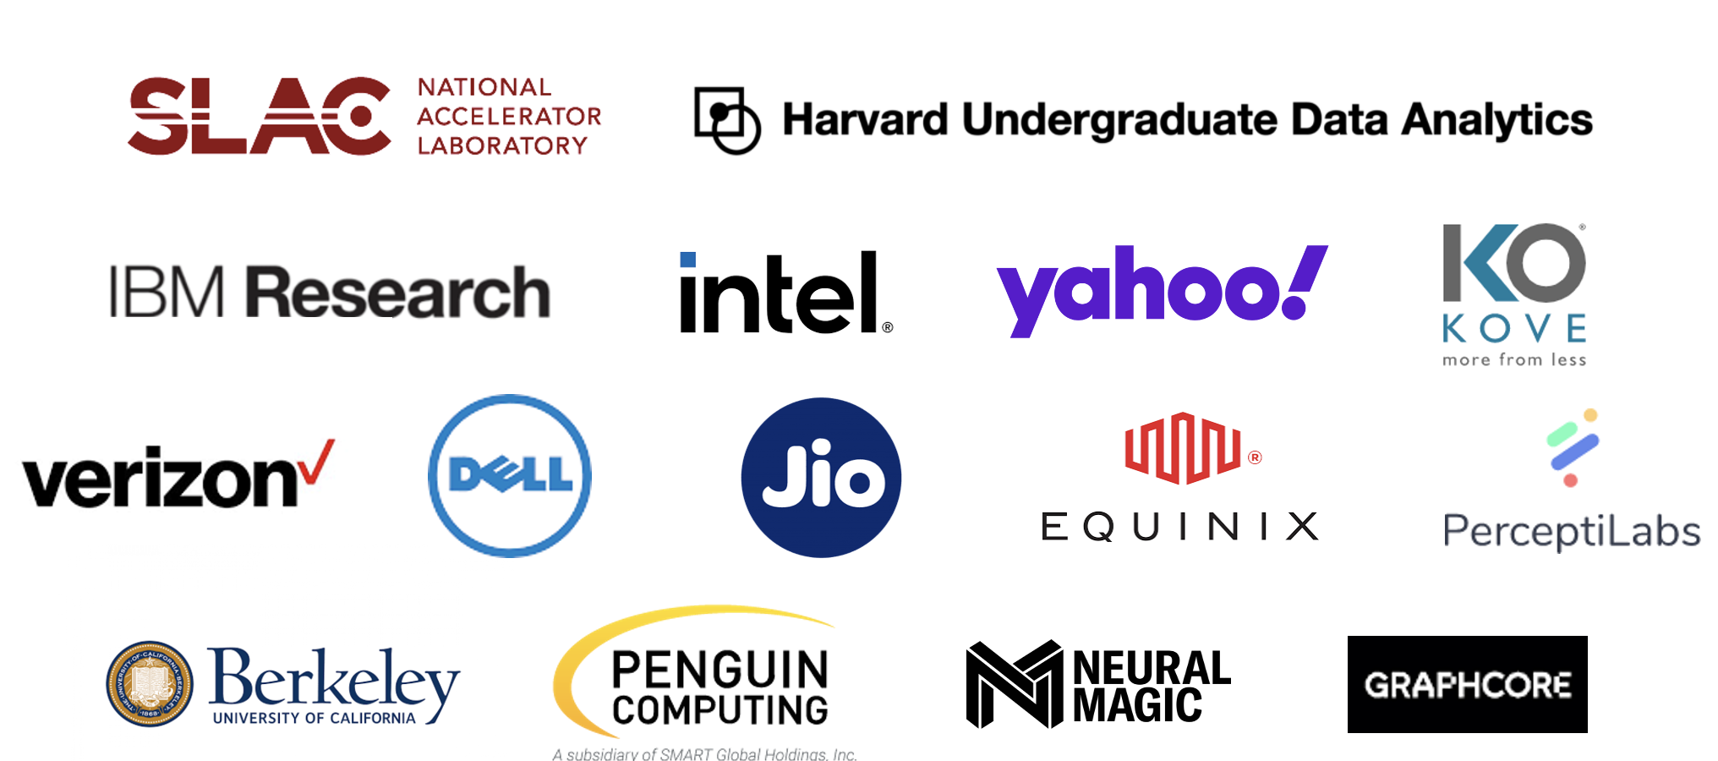



Community members and their organizations
Notes:
Sample list of organizations where our various participants hail from.

Slide 11
Governing Board Chair: Bill Wright, Head of AIML and Intelligent Edge, Red Hat Vice Chair: John Overton, CEO of Kove Technical Committee Lead: Dinesh Verma, CTO Edge at IBM Research REN and Government Representative: Ryan Coffee, Senior Scientist, Stanford National Accelerator Lab, LCLS Financial Services Representative: Vishnu Hari, PM at Meta AI IT Vendor Representative: Ganesh Harinath, CEO of Fiducia AI
Telco Industry Representative: Tong Zhang, Principal R&D Engineer at Intel
Notes:
Governing board membership.

Slide 12
Working Groups Core Intelligence Working Group –Chair: Dinesh Verma, CTO Edge, IBM Research Secure AI Connectivity Fabric Working Group –Chair: Sanjay Aiyagari, Principal Architect for Telco, Edge and AI, Red Hat Telco Working Group –Chair: Ravi Sinha, Director of Technology and Solution Development, Reliance Jio AI-based Signal Processing Working Group – Chair: David Wood, Software Engineering, IBM Research
Notes:
Working group leadership.

Slide 13
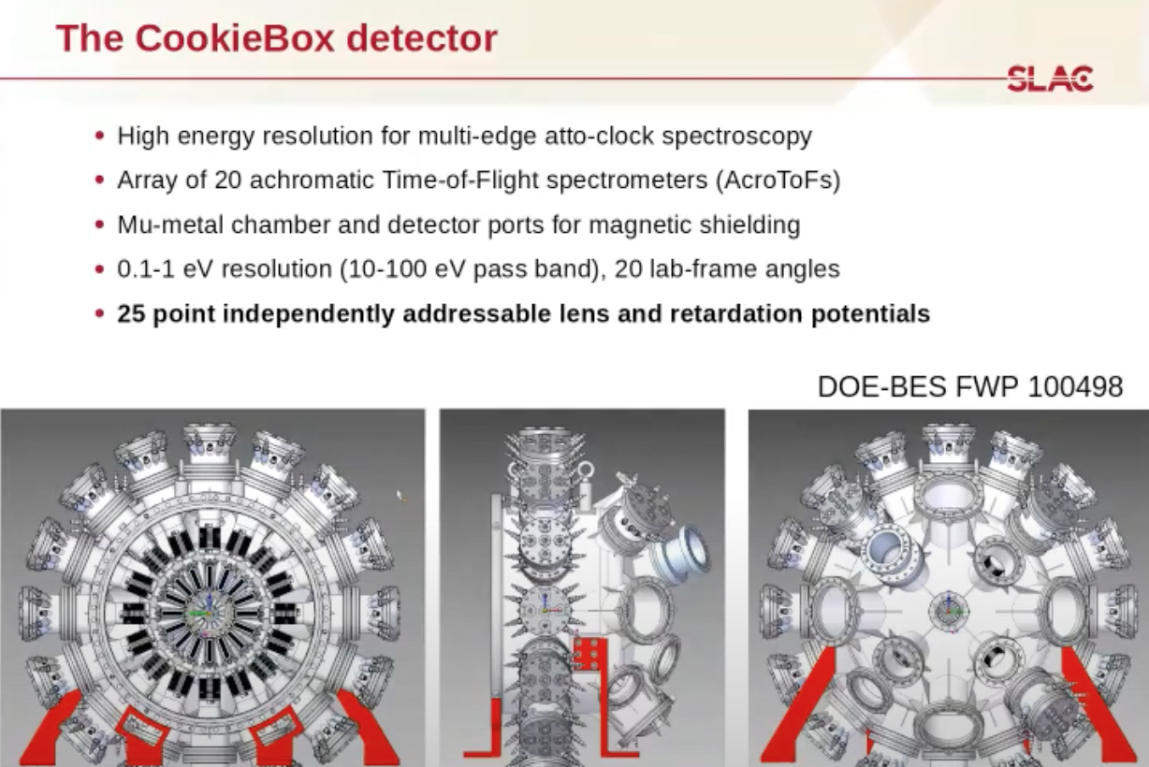
Examples of PoC Activity
Notes:
AI PoC with Stanford SLAC, featuring an academic exercise with Harvard Analytics. This features a transformer/FFT core to edge architecture for their Cookiebox detector.

Slide 14
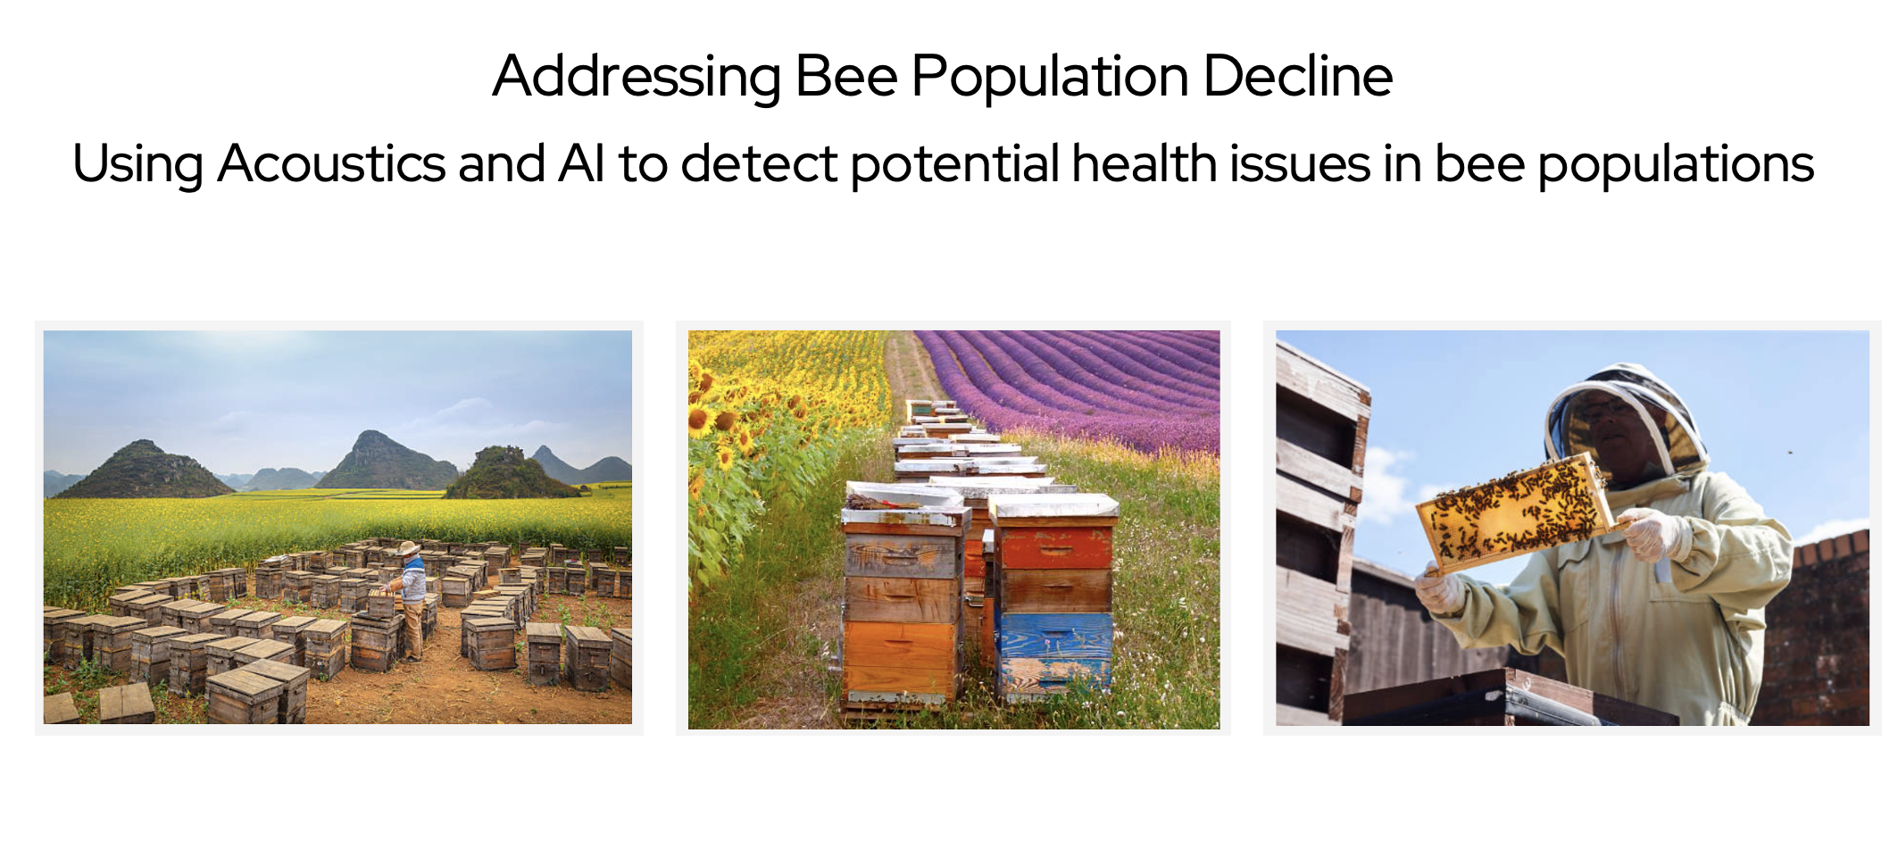
Examples of PoC Activity
Notes:
Managed bee populations are declining rapidly in the US at 45% per year (15% is a typical average), and are considered critical for almonds, blueberries, apples and other crops.
Weather, pollutants and mites are factors, and queen management may also play a role – but deeper analysis is required to determine the causes and related conditions.
Beehive health can be monitored with acoustic analysis – generating unique sounds when in modes of distress.
IBM Research has donated an AI Acoustics software package, which will be made freely available to the global beekeeper community to assist with this analysis.
Proof of concept proposed by Dennis O’Connell of Yahoo!, in partnership with Ryan Coffee at Stanford SLAC.

Slide 15
Thank You
Notes:
Contact: Bill Wright, Enterprise Neurosystem - E) bwright@redhat.com, M) +1-415-710-5207

